Slide 1



FYP 1 Defense
Easy Bazaar- An Online Marketplace
Sell with comfort, buy with confidence

Slide 2

Agenda
Introduction
Use Case Diagrams
Seller
Customer
Shipper
Sequence Diagrams
Seller
Customer
Shipper
Database Design
System Architecture
Implementation Details
Website modules
Mobile App modules
Project Timeline

Slide 3

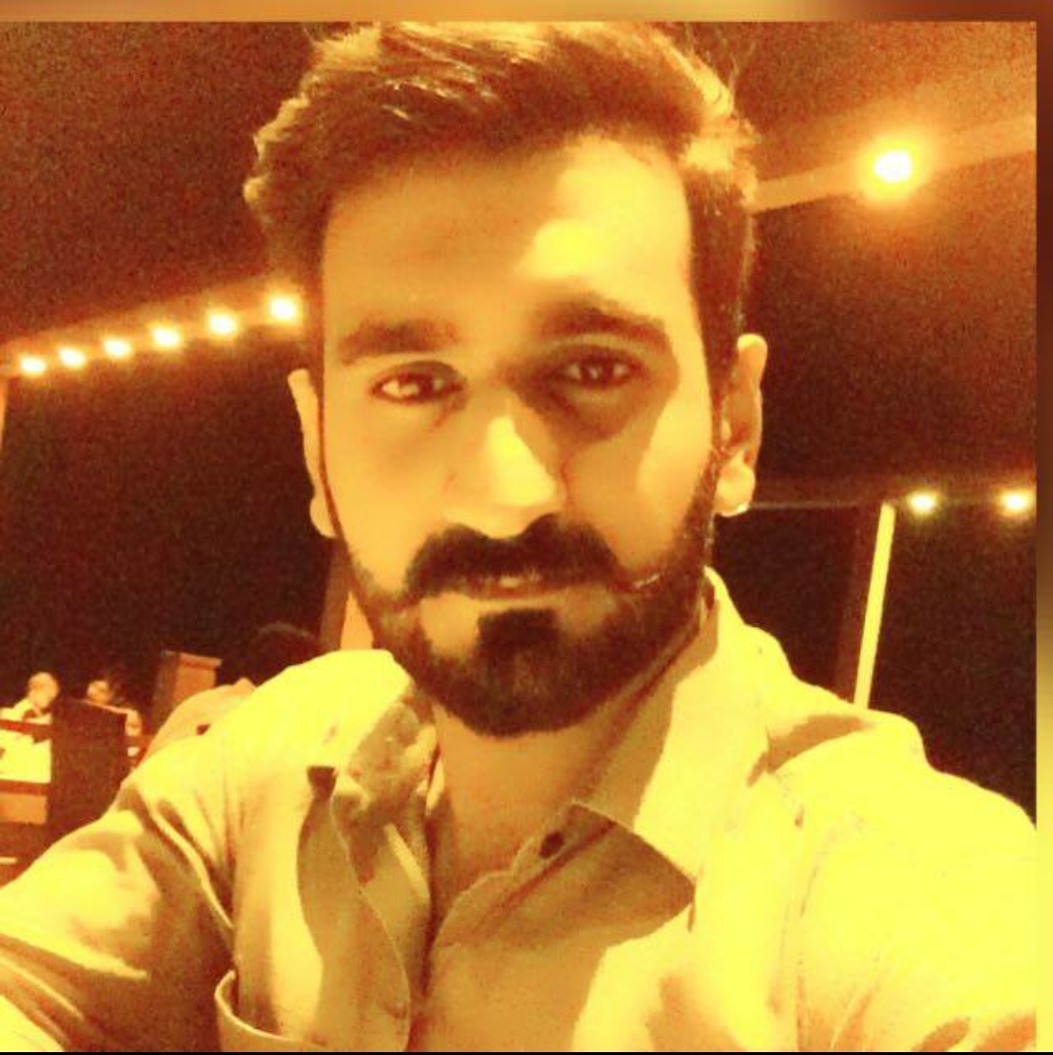
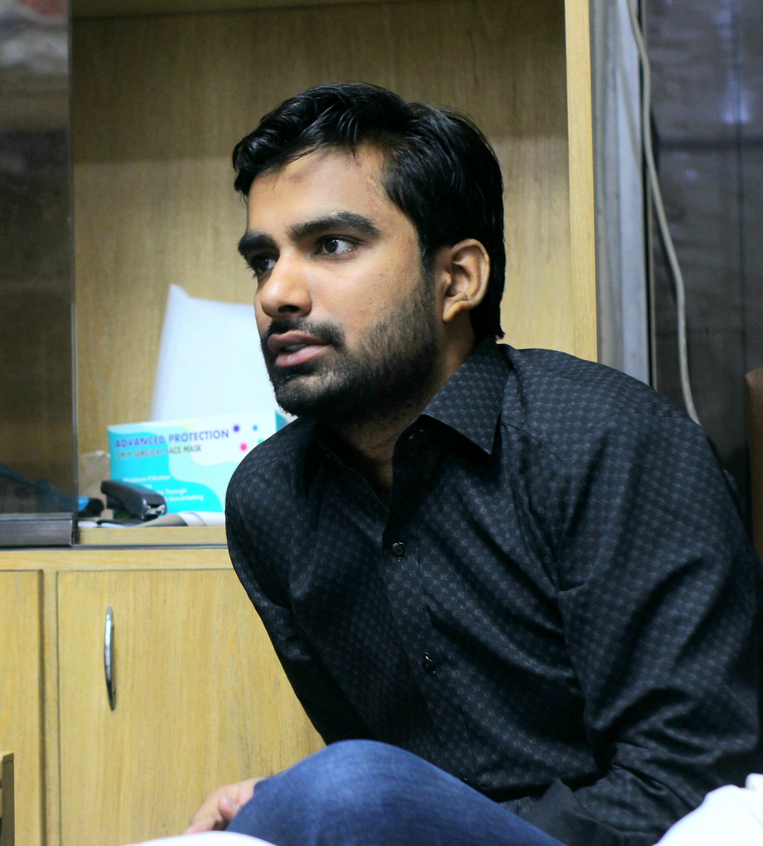
Our Team
Ghayour Haider
Team Member
Mr. Khalid Hussain
Supervisor
Yogesh Talreja
Team Member

Slide 4

Introduction

Slide 5
Easy Bazaar- An Online Marketplace
Easy Bazaar is an online marketplace based on B2C business model.
Tackling following issues in existing marketplaces
No Consumer Protection
Customers’ Trust deficit
Logistics Challenges
Language Barrier
Sell with comfort, buy with confidence

Slide 6
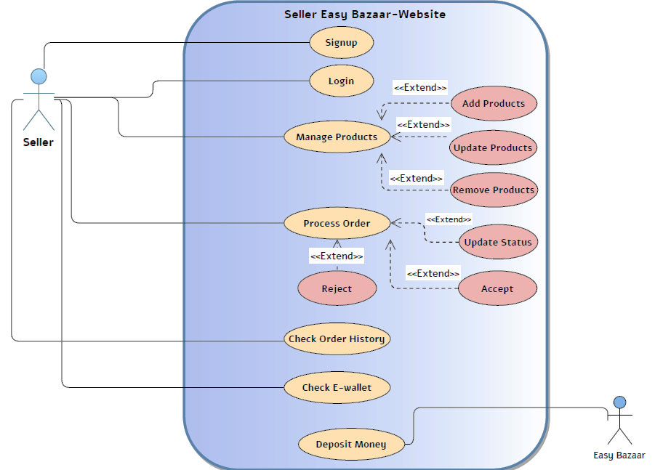
Website
Use Case Diagram
Seller
Actors:
Seller
System (Website)

Slide 7
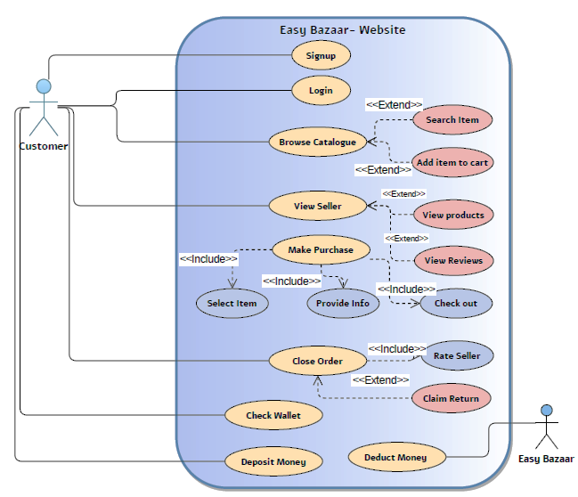
Website
Use Case Diagram
Customer
Actors:
Customer
System (Website)

Slide 8
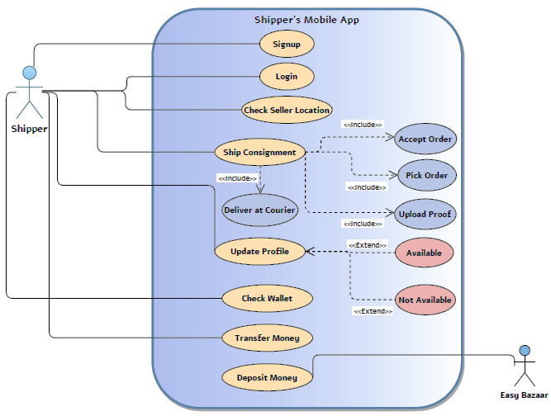
Shipper App
Use Case Diagram
Actors:
Shipper
System (Website)

Slide 9
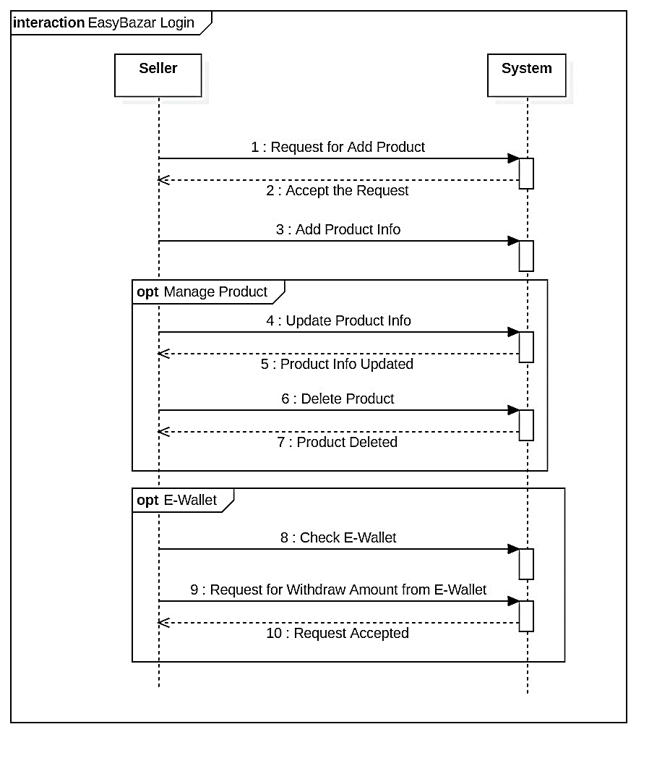
Seller’s
Sequence Diagram
Actors:
Shipper
System (Website)

Slide 10
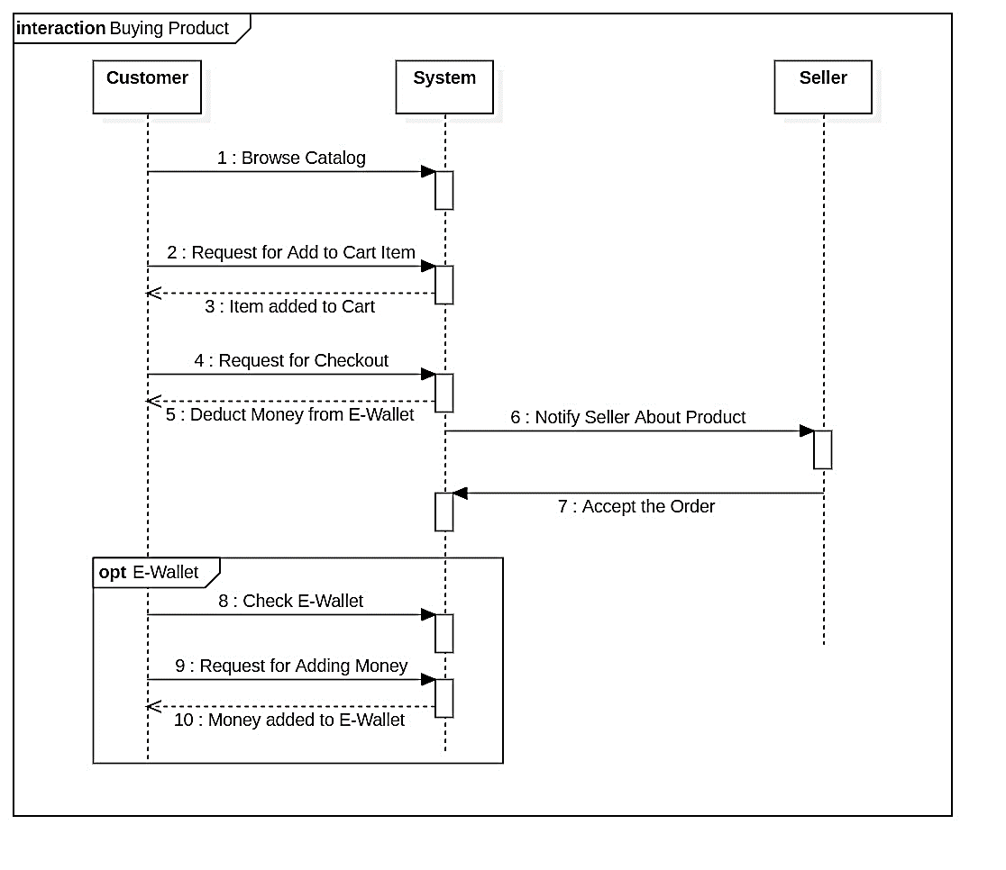
Customer’s
Sequence Diagram

Slide 11
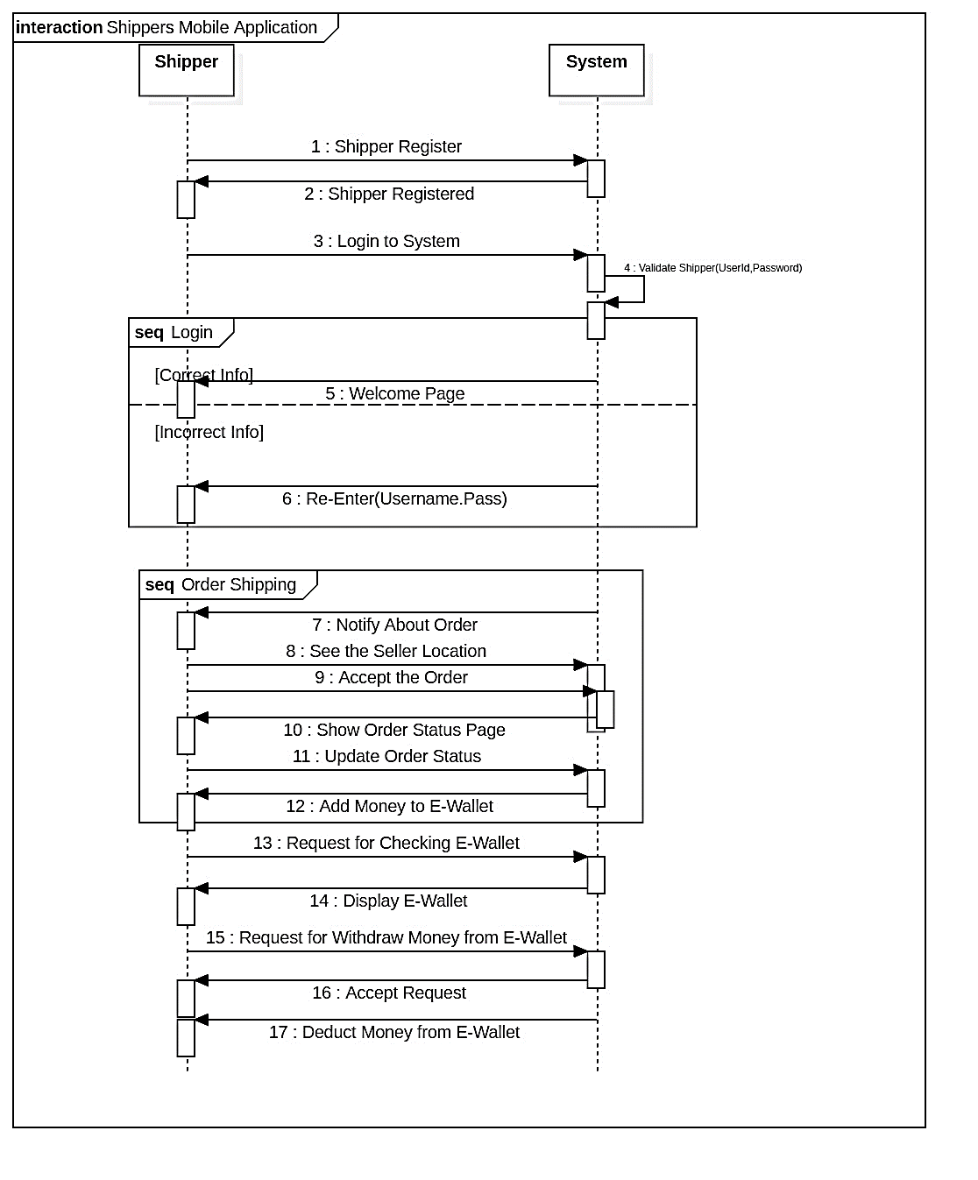
Shipper’s
Sequence Diagram

Slide 12
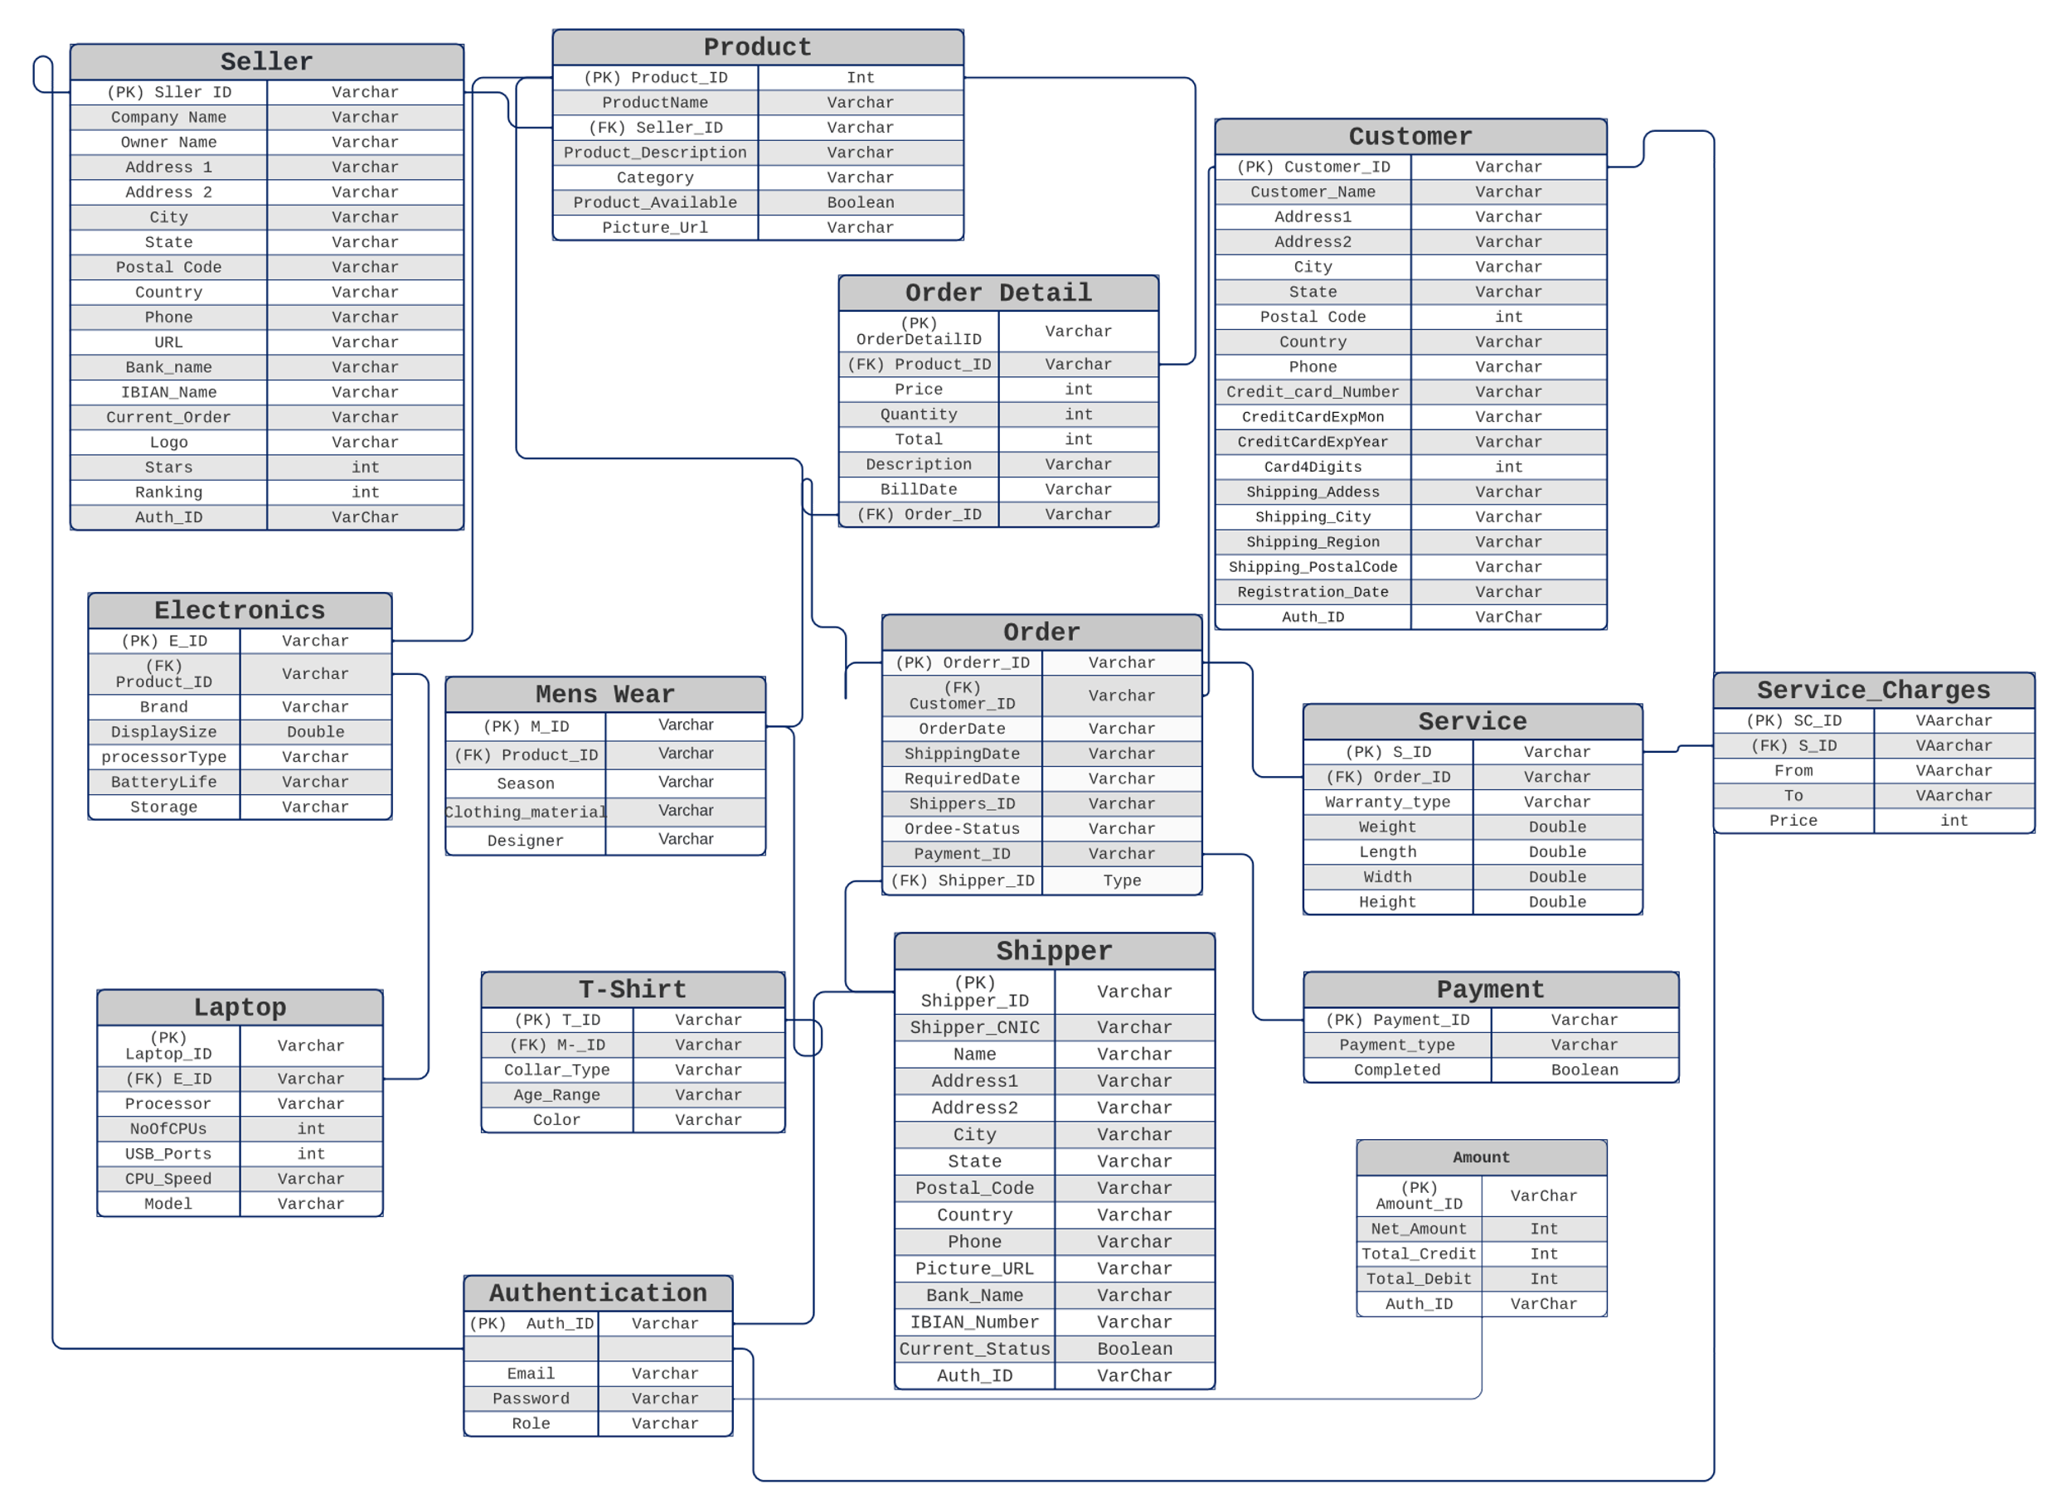
Easy Bazaar
Database Design
Mysql database
15 tables

Slide 13
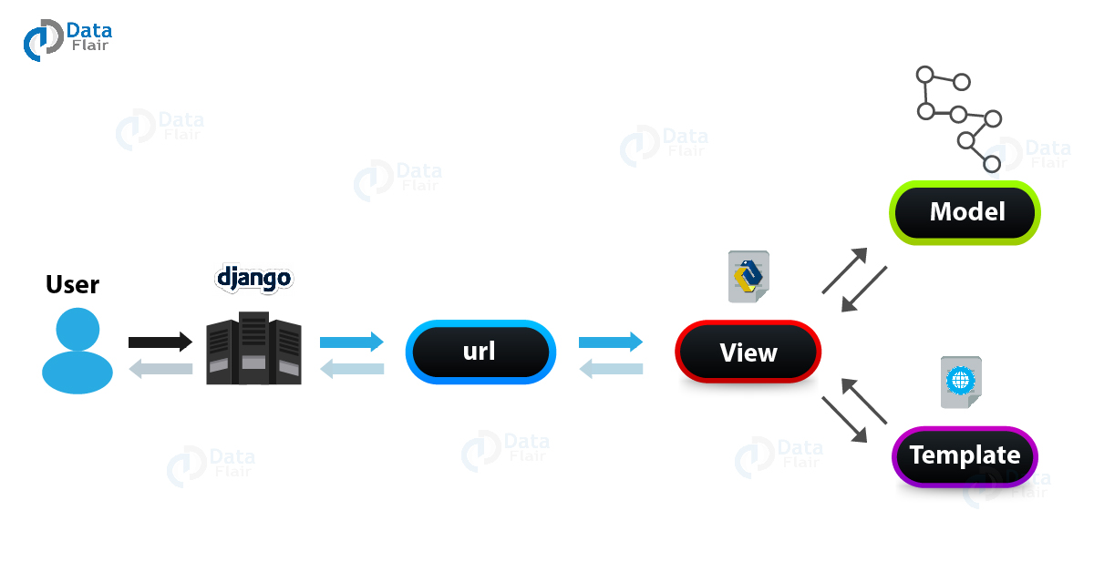
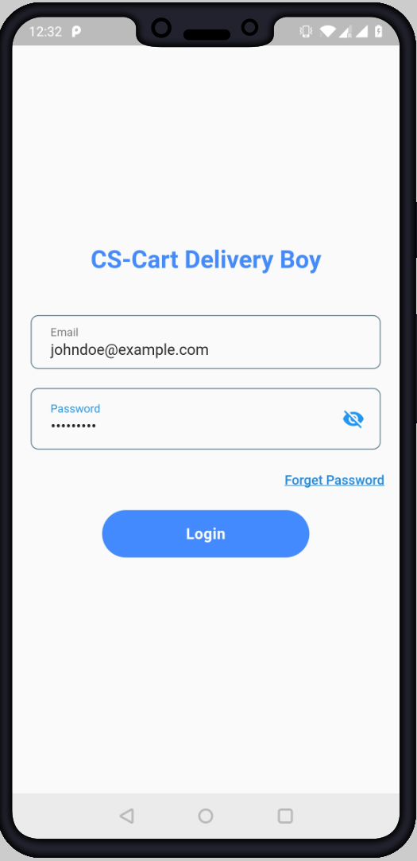





System Architecture
Centralized Database
Model Classes
Server
Page mapping

Slide 14

Implementation Details
Modules |  | Status
Proposal |  | Completed
SRS SDS |  | Completed
Website Modules | Mobile Application Modules
Sign up Module | Sign up Module | Completed
Login Module | Login Module | Completed
Authentication (Single Sign on) | Authentication (Single Sign on) | Completed
Seller Dashboard (Partially Implemented) | Complete UI Design | Completed
Database Design
Database Requirement Analysis |  | Completed
Database Design |  | Completed
Database Implementation |  | Completed
Final Thesis

Slide 15
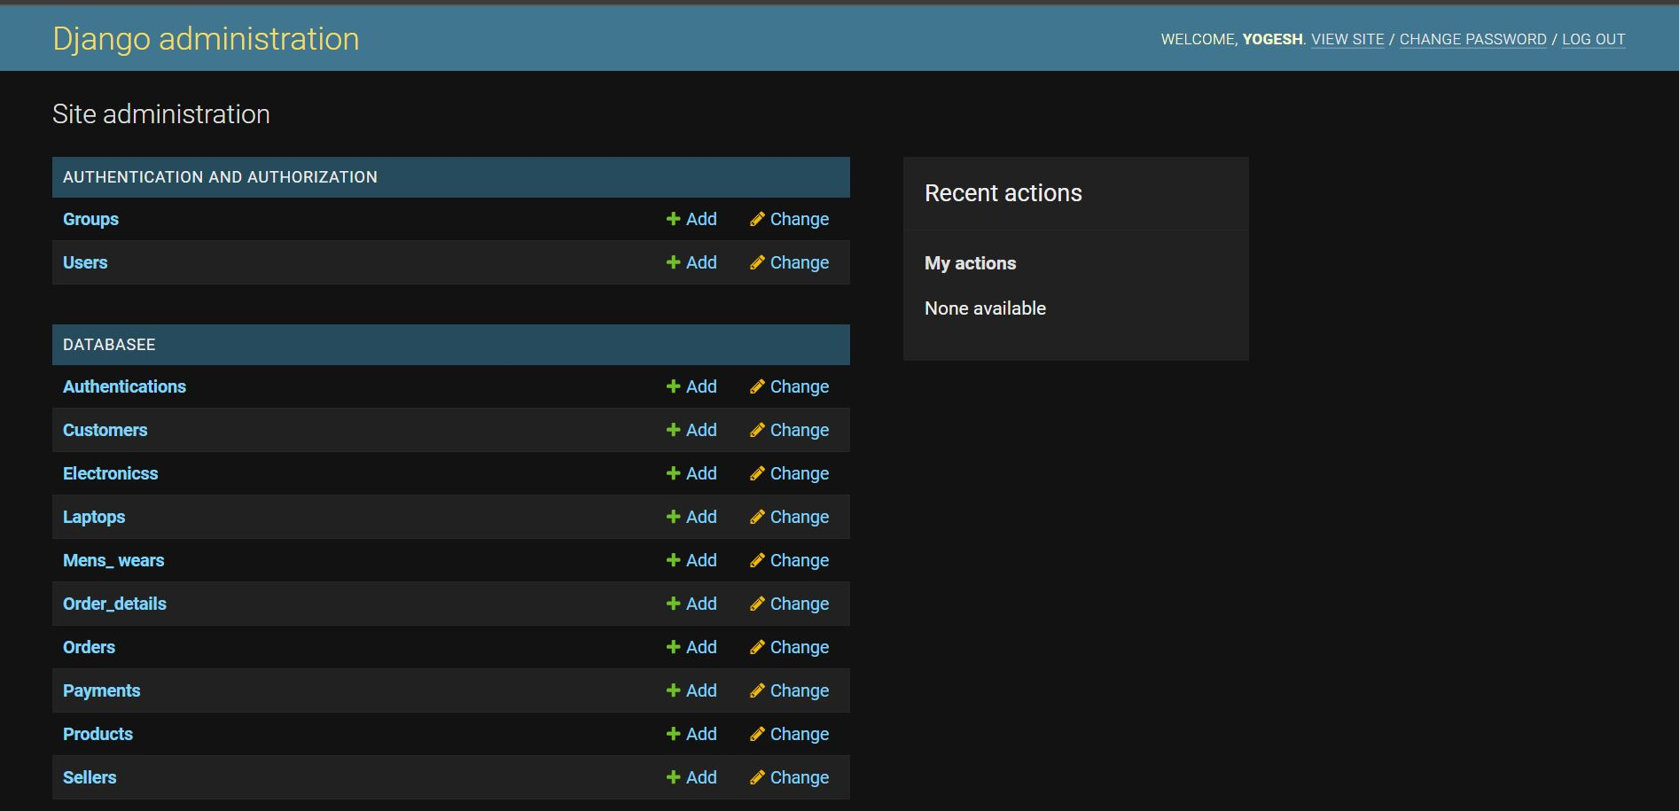
Web based Database Admin Dashboard

Slide 16
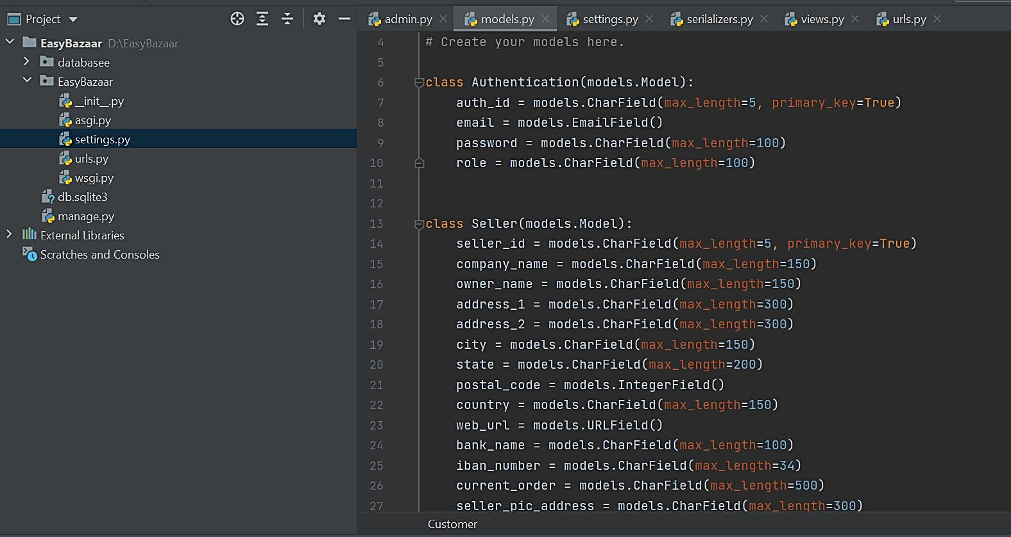
Model Classes
Notes:
E-commerce in Pakistan has witnessed a boom in the past 4 years.
Pakistan’s e-Commerce industry is emerging rapidly and has the potential to strengthen country’s economy.
Rapid internet penetration in the country was the major reason behind
The existing ICT infrastructure is linking remote areas to mainstream. Micro small & medium enterprises unprecedented growth opportunities within and
outside Pakistan through online platforms.
Pakistan is the seventh-largest market in the Middle East, African, and South Asian regions, as measured in Purchasing Power Parity (PPP).
https://www.trade.gov/knowledge-product/pakistan-market-overview#:~:text=With%20a%20population%20of%20approximately,Purchasing%20Power%20Parity%20(PPP).

Slide 17
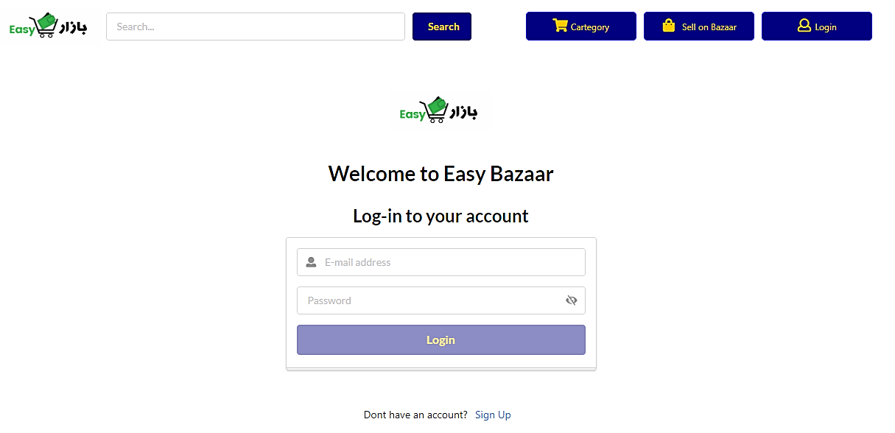
Login Module

Slide 18
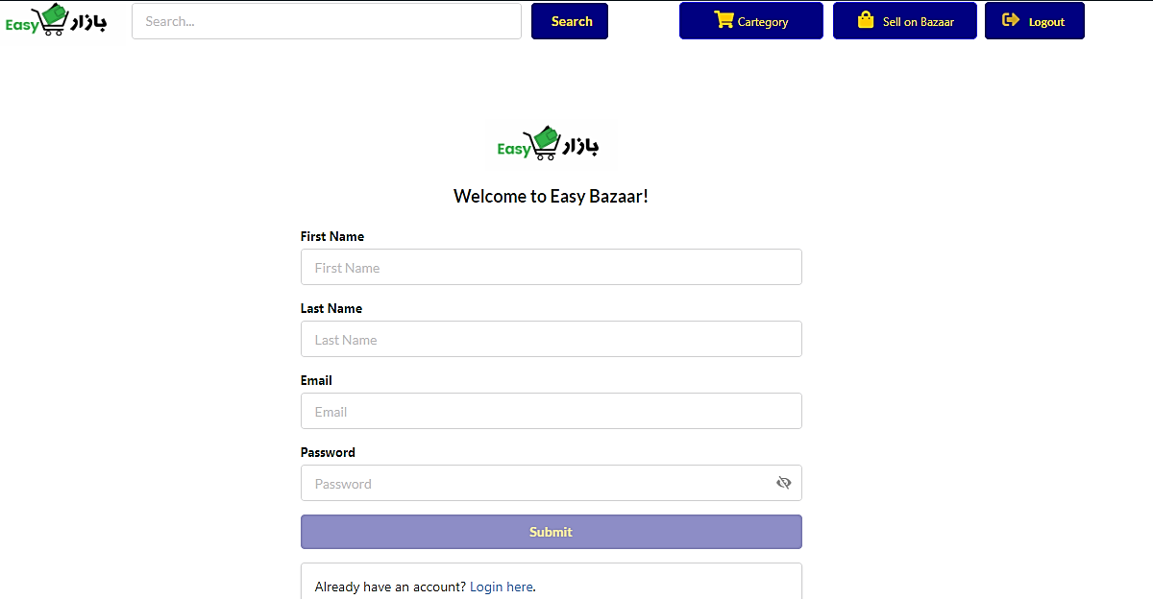
Sign Up Module

Slide 19
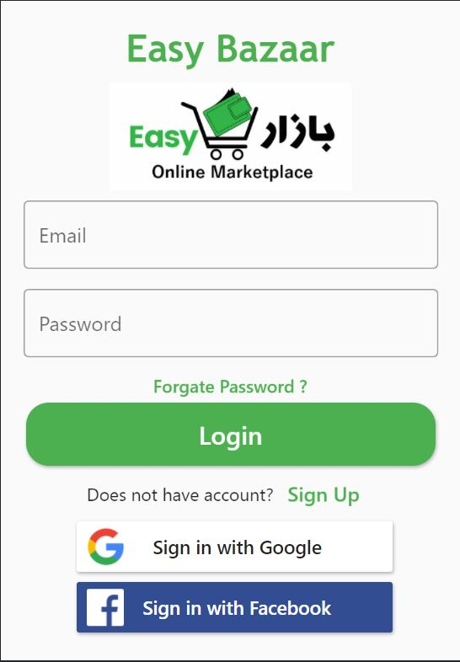
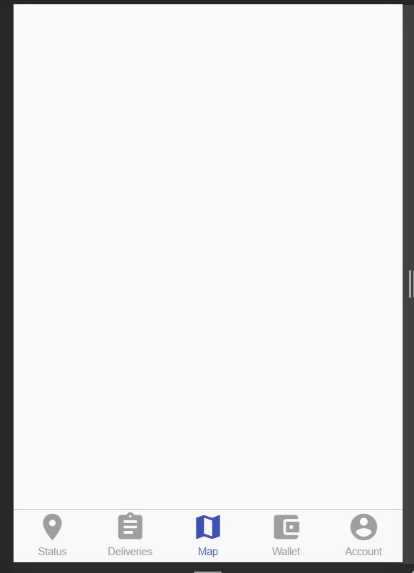
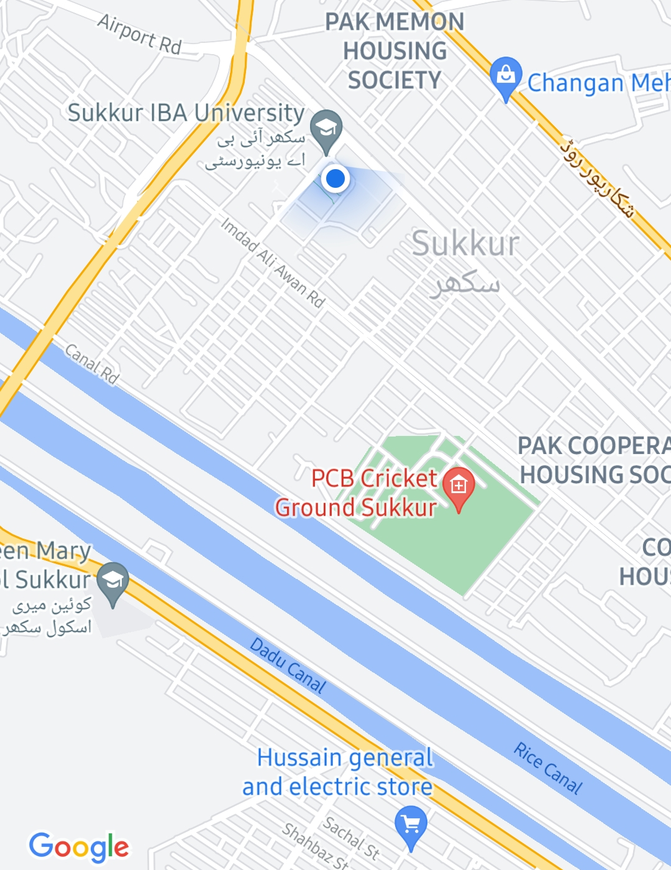
Mobile App
Shipper App
Login Screen
Google Map Screen

Slide 20
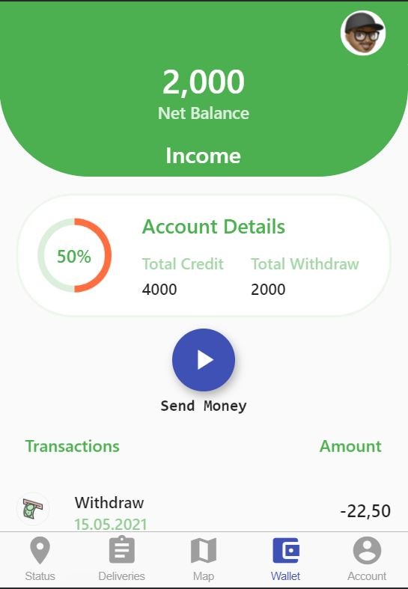
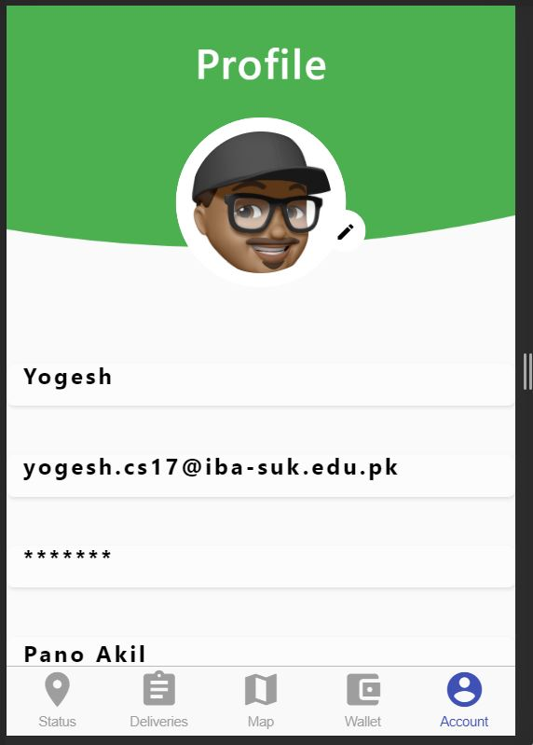
Shipper App
Profile Screen
Wallet Screen

Slide 21
Project TimeLine
2021
Mar
Apr
May
Jun
Jul
Aug
Sep
2021
Today
SRS & SDS
1 Mar - 30 Mar
Database Designing and Implementation
1 Apr - 15 Apr
Mobile Application Development
15 Apr - 23 Jun
Website Development
30 May - 25 Aug
APIs Integration
25 Aug - 2 Sep
Final Thesis
2 Sep - 15 Sep

Slide 22
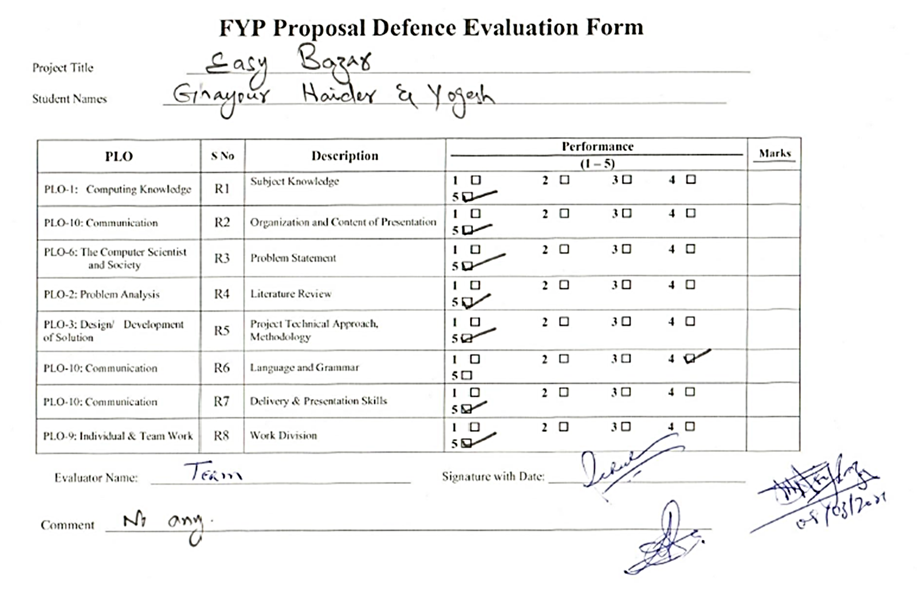
Previous Evaluation
No any comment was given.

Slide 23




Thank you for your attention
Questions and suggestions are welcomed!
Notes:
You can use this slide as your opening or closing slide. Should you choose to use it as a closing, make sure you review the main points of your presentation. One creative way to do that is by adding animations to the various graphics on a slide. This slide has 4 different graphics, and, when you view the slideshow, you will see that you can click to reveal the next graphic. Similarly, as you review the main topics in your presentation, you may want each point to show up when you are addressing that topic.
Add animation to images and graphics:
Select your image or graphic.
Click on the Animations tab.
Choose from the options. The animation for this slide is “Split”. The drop-down menu in the Animation section gives even more animations you can use.
If you have multiple graphics or images, you will see a number appear next to it that notes the order of the animations.
Note: You will want to choose the animations carefully. You do not want to make your audience dizzy from your presentation.

